Slide 1

Linear and Logistic Regression
Simple, yet powerful predictors
Yordan Darakchiev
Technical Trainer
yordan@softuni.bg

Slide 2
Sli.do
#softuni-regr

Slide 3
Table of Contents
Regression and classification – problem statement
Linear regression
Objective, cost function, algorithm, analysis
Improvements: robust regression with outliers, polynomial features
Common mistakes
Logistic regression
Objective, cost function, algorithm
Improvement: many classes

Slide 4
Linear Regression
Predict continuous values… and torture first-semester students

Slide 5


Regression
Predict target variables on a continuous scale
Based on the input variables
Example: Predicting the sales of a company in the next six months
Simple linear regression
Model the data with a straight line
Usually there's no straight line through all points
We're looking for "the best" line approximation (fit)
Simulating data points with noise
(x, y) pairs with a linear relationship described by
– error term – e.g. random uniform noise (smaller => better fit)
def simulate_points(a, b, max_noise):
pass

Slide 6



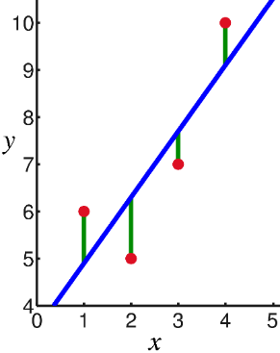

Linear Regression Cost Function
All ML models work with a cost function
Describes how far away we are from the goal
=> Penalty we want to give the model
Low penalty may lead to overfitting
Suppose we know the hyperparameters
For each point calculate the predicted value
Measure the distance between predicted and real:
Total cost: sum of all differences?
Doesn't work well (remember degrees of freedom)
Better cost function: squared differences:
Always returns a non-negative error
Emphasizes outliers (can be good or bad)
Continuous and differentiable everywhere

Slide 7
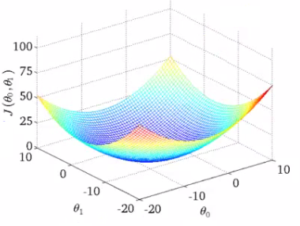
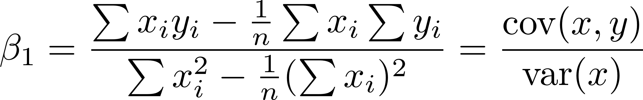

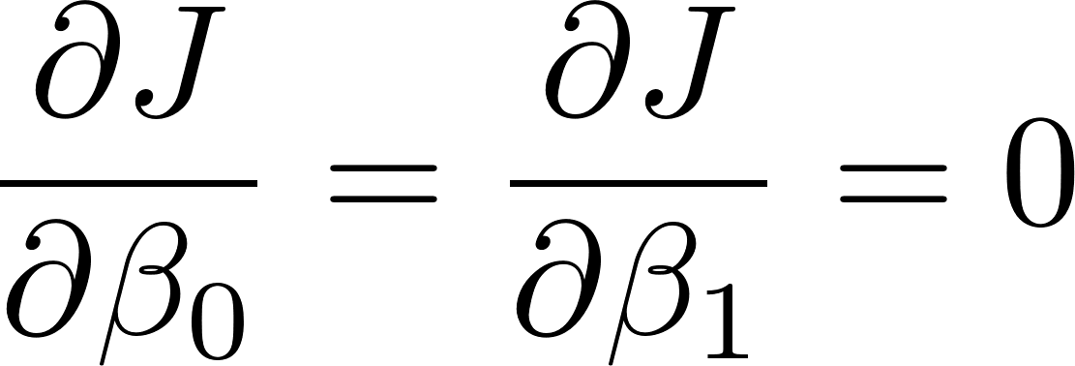
Linear Regression Objective
Minimize the cost function
That's why the method is called "least squares"
Paraboloid ("3D" parabola)
1 global minimum
We use gradient descent to find its "bottom"
The best fit line has parameters
We won't go into calculation details
Main idea: min is where

Slide 8
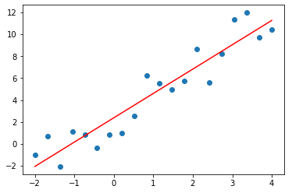
Lab: Linear Regression with scikit-learn
Although we can write the calculations, it's easier to use a library such as scikit-learn
Contains almost all machine learning models with various modifications and settings
Provides a simple and unified API
Allows pipelining ("chaining" data processing operations)
from sklearn.linear_model import LinearRegression
model = LinearRegression()
points = simulate_points(2, 3, 2.5)
x = points[0].reshape(-1, 1)
model.fit(x, points[1])
y_predicted = model.predict(x)
plt.scatter(points[0], points[1])
plt.plot(points[0], y_predicted, color = "red")
print(model.coef_, model.intercept_)

Slide 9
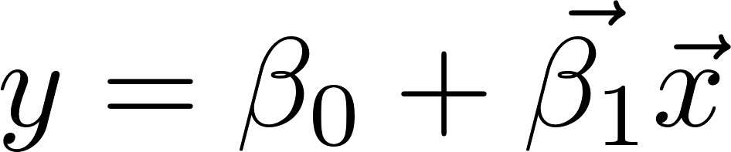
Lab: Linear Regression on Real Data
The algorithm can be generalized to more than 2D
"Multiple linear regression":
Let's use this model to try and predict housing prices (a classical dataset located here)
First, we want to explore the datasets
A more thorough exploration is "left as an exercise to the reader"
But we want to see what model would be appropriate
In addition to usual data analysis techniques, let's plot all correlations between any pair of features
housing.columns = ["crime_rate", "zoned_land", "industry", "bounds_river", "nox_conc", "rooms", "age", "distance", "highways", "tax", "pt_ratio", "b_estimator", "pop_status", "price"]

Slide 10
Plotting Correlations
A correlation matrix is… well, a matrix of all Pearson correlation coefficients
We can plot it as a "heatmap" for better viewing (using seaborn)
We can also view correlations of attribute pairs
We'll select a subset of all attributes for a smaller chart
We can see that most correlations are, indeed, linear
housing.corr()
import seaborn as sns
sns.heatmap(housing.corr())
import seaborn as sns
sns.heatmap(housing.corr(), annot = True, fmt = ".2f", square = True)
sns.pairplot(housing[["pop_status", "industry", "nox_conc", "rooms", "price"]])

Slide 11
Creating a Model
Modelling is very simple
Like in the 2D example
So what?
We might want to predict some prices
Let's just pass some random rows and see the result
Note: Never test on the training dataset!
housing_model = LinearRegression()
predictor_attributes = housing.drop("price", axis = 1)
housing_model.fit(predictor_attributes, housing.price)
print(housing_model.coef_)
print(housing_model.intercept_)
indices = np.random.randint(0, len(housing), 5)
houses = housing.ix[indices]
predicted = housing_model.predict(houses.drop("price", axis = 1))
print(predicted)
print(houses.price)

Slide 12
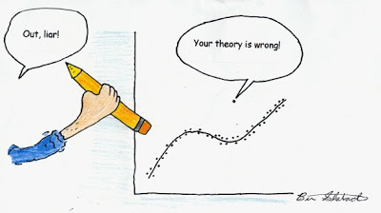
Regression with Outliers
As we saw, the data has outliers
A few points which are far from the others
Our goal is to exclude outliers
There are several methods
One very common – RANSAC (RANdom SAmple Consensus)
Algorithm
Fit a model to a random subsample ("inliers")
Test all data points and include those which are "near" the model
Small enough error, tolerance provided by developer
Fit the model again
Estimate the error of the model (difference between first and second)
Iterate 1-4 until performance reaches a threshold or number of iterations

Slide 13
Lab: RANSAC on the Housing Dataset
Usage: similar to the linear regression model
We can also provide parameters, e.g. min number of random samples, max iterations, threshold (to include data points)
We can also provide the type of model we want to perform RANSAC on
Linear regression by default but we may use other regression models
View inliers and outliers
from sklearn.linear_model import RANSACRegressor
ransac = RANSACRegressor()
ransac.fit(housing.drop("price", axis = 1), housing.price)
print(ransac.estimator_.coef_, ransac.estimator_.intercept_)
ransac = RANSACRegressor(LinearRegression(), min_samples = 50, max_trials = 100, residual_threshold = 5.0)
inliers = housing[ransac.inlier_mask_]
outliers = housing[~ransac.inlier_mask_]
plt.scatter(inliers.rooms, inliers.price)
plt.scatter(outliers.rooms, outliers.price)

Slide 14
Polynomial Regression
Extension of the linear regression algorithm
We can use the linear regression algorithm to perform polynomial regression (e.g. fitting a quadratic curve)
Just precompute the columns
Example: if we have columns x, y and z, compute x * z, y * z, x * z and perform linear regression on these 6 features
Example 2: polynomial terms: multiply x by itself: x * x, x * x * x, etc.
This can be achieved easily with scikit-learn
from sklearn.preprocessing import PolynomialFeatures
x = np.arange(6).reshape(3, 2)
poly = PolynomialFeatures(2)
x_transformed = poly.fit_transform(x)
print(poly.get_feature_names())
print(poly.n_input_features_)
print(poly.n_output_features_)

Slide 15
Lab: Polynomial Regression
Create test data
Fit a simple and a multiple regression model
Test both models
x = np.array([258.0, 270.0, 294.0, 320.0, 342.0, 368.0, 396.0, 446.0, 480.0, 586.0])[:, np.newaxis]
y = np.array([236.4, 234.4, 252.8, 298.6, 314.2, 342.2, 360.8, 368.0, 391.2, 390.8])
quadratic = PolynomialFeatures(degree = 2)
x_quad = quadratic.fit_transform(x)
lin_model = LinearRegression()
quad_model = LinearRegression()
lin_model.fit(x, y)
quad_model.fit(quadratic.fit_transform(x), y)
x_test = np.arange(250, 600, 10)[:, np.newaxis]
y_lin_model = lin_model.predict(x_test)
y_quad_model = quad_model.predict(quadratic.fit_transform(x_test))
# TODO: Plot test points

Slide 16
Lab: Quadratic Regression
Create test data
Fit a simple and a multiple regression model
Test both models
x = np.array([258.0, 270.0, 294.0, 320.0, 342.0, 368.0, 396.0, 446.0, 480.0, 586.0])[:, np.newaxis]
y = np.array([236.4, 234.4, 252.8, 298.6, 314.2, 342.2, 360.8, 368.0, 391.2, 390.8])
quadratic = PolynomialFeatures(degree = 2)
x_quad = quadratic.fit_transform(x)
lin_model = LinearRegression()
quad_model = LinearRegression()
lin_model.fit(x, y)
quad_model.fit(quadratic.fit_transform(x), y)
x_test = np.arange(250, 600, 10)[:, np.newaxis]
y_lin_model = lin_model.predict(x_test)
y_quad_model = quad_model.predict(quadratic.fit_transform(x_test))
# TODO: Plot test points

Slide 17
Lab: Other Types of Regression
In a similar manner, we can use other transformations of the data (e.g. sqrt, log, trigonometry functions, etc.) and regress on them
If all features have constant coefficients, it's perfectly fine to precompute them and use linear regression
Do a linear, quadratic and cubic regression on the housing dataset
* Which one is the best? (We'll be able to answer later)
Look at the "pop_status" and "price" columns
We can try polynomial regression on them
No regression seems good enough
The relationship looks somewhat exponential
Try a simple linear regression on sqrt(price) vs. log(pop_status)
* It's better than all three other models. How do we know that?

Slide 18
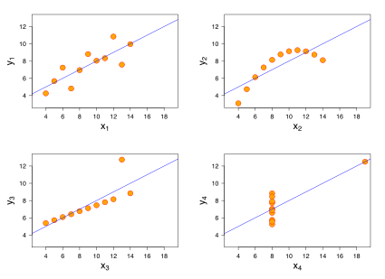
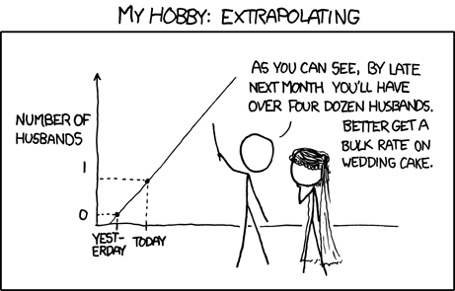
Common Mistakes
There are two main types of errors we can make while trying regression models
Use a wrong model
Anscombe's quartet
Extrapolate without knowing (especially if we have interacting features)

Slide 19
Logistic Regression
Use a regression model to classify

Slide 20
Classification
Predict one of several known classes
Based on the input parameters
Example: classify whether a picture is of a cat or a dog
Regression and classification make up most of the ML problems
Choosing an algorithm
"No free lunch": no single algorithm works best
It's best to compare some algorithms to select the best for a particular model
Also, we might want to tune them first
Reminder: ML process
Select features, choose a performance metric (cost function), choose a classifier, evaluate and fine-tune the performance

Slide 21


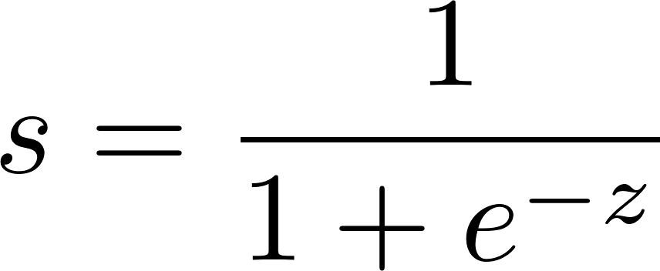
Logistic Regression
Classification algorithm (despite its name)
Two classes: negative (0) and positive (1)
Can be extended to more classes
Why does it work?
Odds ratio of an event with probability p:
The log-transform (logit function):
We're interested in the inverse function
Predicting the probability that a sample belongs to a given class
Inverse of the logit function: logistic function (sigmoid)
z – linear combination of parameters and their weights,

Slide 22
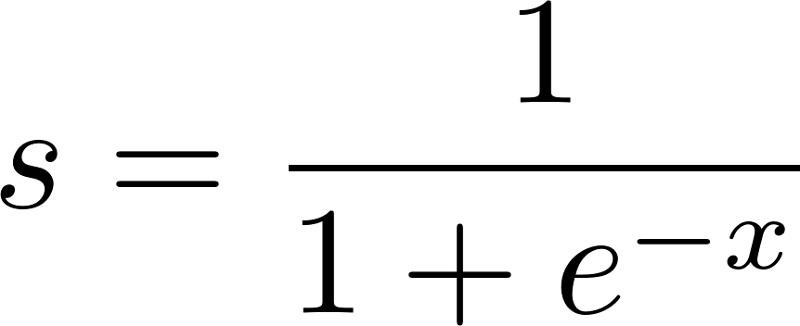

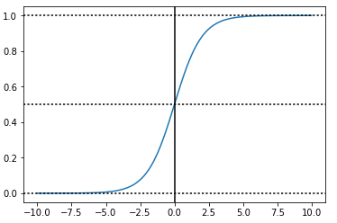
Lab: Logistic Regression Function
Plot the logistic regression function for some interval of real numbers, e.g.
Tends to 0 for small x and 1 for large x, with value 0.5 at x = 0
Interpretation: probability of a particular sample belonging to class 1
Logistic regression outputs not only classes but also their probabilities
Quantization: select a threshold, e.g. 0.5; class 1 if J > threshold
x = np.linspace(-10, 10, 1000)
y = 1 / (1 + np.exp(-x))
plt.plot(x, y)
plt.axhline(0, ls = "dotted", color = "black")
plt.axhline(0.5, ls = "dotted", color = "black")
plt.axhline(1, ls = "dotted", color = "black")
plt.axvline(0, color = "black")
plt.show()

Slide 23
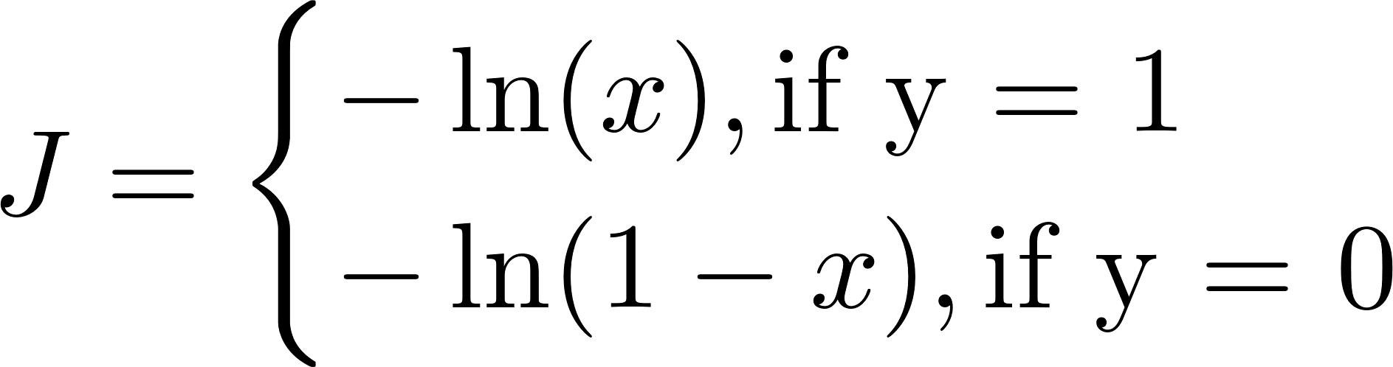
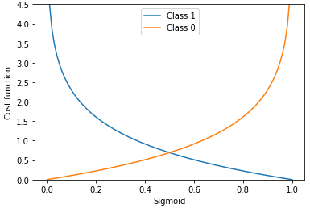
Logistic Cost Function
To apply gradient descent, we need a proper cost function
When we're right, the cost is 0
It gradually increases if we're wrong
Plot the logistic cost function and the error functions to get a feel of what they look like
x = np.linspace(0.001, 1, 100)
class_1 = -np.log(x)
class_0 = -np.log(1 - x)
plt.plot(x, class_1, label = "Class 1")
plt.plot(x, class_0, label = "Class 0")
plt.xlabel("Sigmoid")
plt.ylabel("Cost function")
plt.ylim(0, 4.5)
plt.legend()
plt.show()

Slide 24
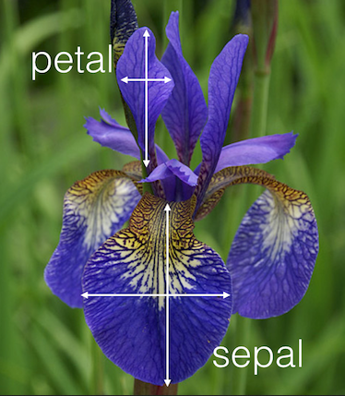

Lab: Logistic Regression on Real Data
A classic dataset for classification is the iris dataset
Located here
Three classes (setosa, virginica, versicolor)
4 attributes: petal width / height; sepal width / height (all in cm)
Some features are highly correlated to the class
Explore and inspect the data before modelling

Slide 25
Lab: Logistic Regression on Real Data (2)
Take out 5 random samples beforehand (to test)
Perform logistic regression
Test (output classes or probabilities)
In the model, there's a "mysterious" parameter C
Regularization: how powerful the data is (more – next time)
test_indices = np.random.randint(0, len(iris), 5)
train_indices = np.delete(np.arange(len(iris)), test_indices)
iris_train = iris.ix[train_indices]
iris_test = iris.ix[test_indices]
# TODO: Split the labels from the other attributes
from sklearn.linear_model import LogisticRegression
model = LogisticRegression(C = 1000)
model.fit(iris_train_data, iris_train_labels)
print(model.predict(iris_test))
print(model.predict_proba(iris_test))

Slide 26
Many Classes
Two main approaches
One-vs-all: several predictors
One predictor for each class vs. the others
Overall: calculate probabilities of each class
Scikit-learn takes care of multiple classes (multinomial logistic regression) by default
We don't even need to transform the labels

Slide 27
Summary
Regression and classification – problem statement
Linear regression
Objective, cost function, algorithm, analysis
Improvements: robust regression with outliers, polynomial features
Common mistakes
Logistic regression
Objective, cost function, algorithm
Improvement: many classes

